Slide 1



BAN6800: Business analytics capstone
Milestone 2 Assignment: Business Analytics Model Results Communication
Taco-Tel’s Shield360 Project
Leveraging data and Machine Learning (GBDT) for Subscriber Retention
VOKE HARRISON EDAFEJIMUE
Learner ID: 143304
Presented by: Voke H. Edafejimue | Date: April 21, 2025
Notes:
Welcome, our esteemed Taco-Tel Executives, Compliance Officer, Chief Financial Officer, Customer Experience Lead, Marketing/Retention Strategy Lead, and other stakeholders here present today. My name is Voke Harrison Edafejimue, and Today we will be exploring our data-driven business analysis project called Shield360. This project is aimed at helping Taco-Tel reduce subscriber churn and protect its long-term relevance and profitability.

Slide 2
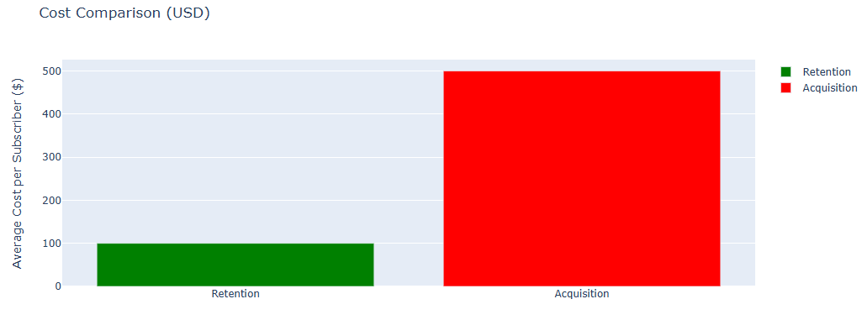
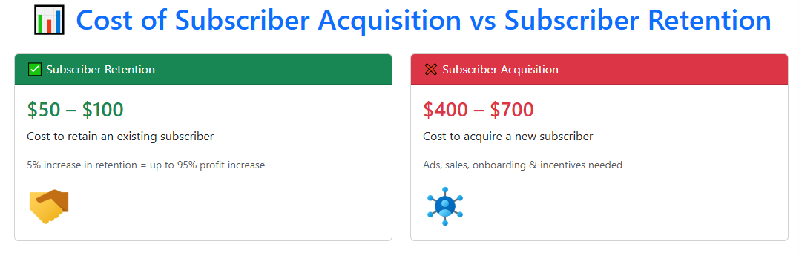
INTRODUCTION
Taco-Tel is a profitable telecommunications company with steady growth over the years. However, there has been a spike in subscriber churn rate, significantly impacting the business revenue generation and increasing new subscriber acquisition costs. It’s been proven that retaining existing subscribers is cheaper than gaining new ones (Kumar, 2022), hence, this initiative will help us understand subscriber churn patterns so that we can use technology to reduce such attrition.
Notes:
Taco-Tel has been a profitable telecommunications service provider, however, in the past few quarters, we have experienced an increasing trend in subscriber churn, meaning our subscribers are leaving for competitors. This attrition impacts our profitability and acquiring new customers is becoming increasingly costly. Infact, studies have shown acquiring a new subscriber is 5 to 8 times more expensive than retaining existing ones, as existing subscribers are more likely to patronize the business over and over again over a long time.

Slide 3

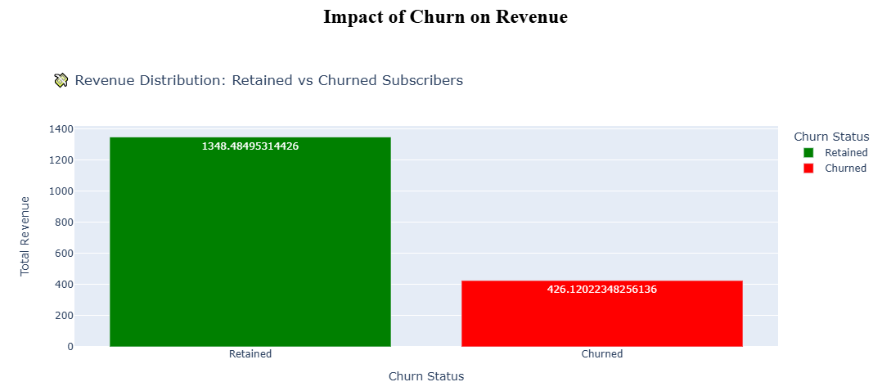
Business problem
Despite the company’s consistent revenue generation and increased subscriber base, Taco-Tel has experienced a quick rise in subscriber churn, resulting in income leakage, growing subscriber acquisition costs, and diminishing Lifetime value of its customers (Rastogi, 2022).
Notes:
Although our company has consistently generated revenue, a deep dive using data analytics reveals that there are patterns tied to tenure, service type, contract length, and customer demographics that contribute to the increasing churn trend and ultimately lead to revenue loss. Identifying these churn factors can help us reduce these losses and improve long-term profitability. Our chosen model, GBDT, can predict which subscribers are likely to churn, and from the graph on the screen, it shows that subscribers who churn represent about $426,000 in revenue lost. On the other hand, if these same customers are retained, we will earn approximately $1,348,000 in total revenue. Shockingly, this represents about 24% of our revenue that is at risk due to this problem. However, if we invest in proactive measures such as loyalty programs, customized ads, and targeted special offers using the outputs of this solution, we will retain and grow our profits. Imagine even reducing the churn rate by just 10%, we retain approximately $42,600. This loss is not just about a depleting subscriber base, it is about income leakage that directly impacts Taco-Tel’s sustainability.

Slide 4
DATA COLLECTION & PREPROCESSING
To achieve these results, we had to collect data from multiple sources.
Sources:
Telco_customer_churn.csv – main churn information.
Telco_customer_churn_demographics.csv – customer demographics.
Telco_customer_churn_location.csv – geographic info.
Telco_customer_churn_population.csv – population details.
Telco_customer_churn_services.csv – service utilization and billing data.
Telco_customer_churn_status.csv – subscriber churn status.
These sources were merged into a comprehensive view of the subscriber database. Afterward, we handled all inconsistencies to ensure data consistency and reliability.
Remove duplicate data and missing data, that is, the null values
Categorical Data encoding.
Numerical Data scaling
Notes:
To help us make sense of the current churn state, we need reliable data to drive this project. Therefore, in this phase, data was sourced from 6 interrelated datasets from within the company, with each dataset adding a unique and relevant perspective. First, these datasets were merged into a comprehensive view and then cleaned. We handled duplicates, null values, and encoded the data to make the data prediction model-ready. To ensure that our predictions are reliable and actionable, the data must be of high quality and consistent.

Slide 5
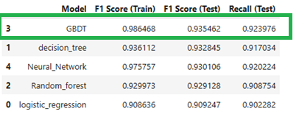
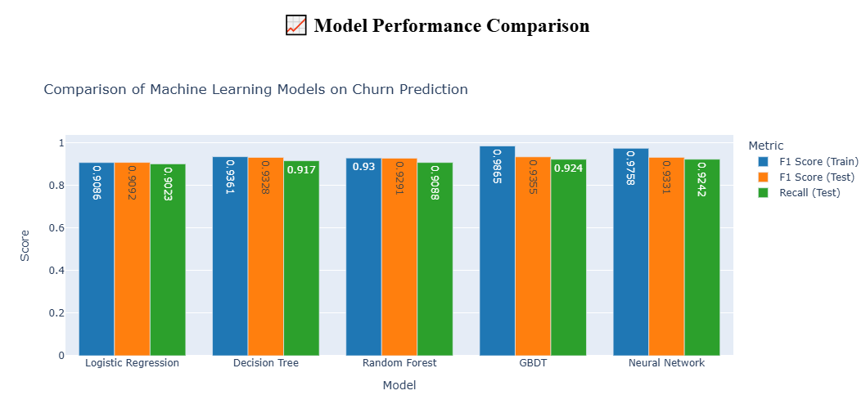
THE SOLUTION: SUBSCRIBER CHURN PREDICTION
For this project, we tested 5 machine learning techniques: Logistic Regression, Decision Trees, Random Forests, a Neural Network, and Gradient Boosted Decision Trees (our chosen model), with a Test score of 93%. In addition, an interactive dashboard/report that provides live and actionable insights into churn predictions and the factors responsible for subscriber churn has been deployed. These tools will help Taco-Tel execute targeted interventions to retain high-value subscribers, increase revenue generation, and enhance decision-making.
Notes:
With this consolidated view, we selected, trained, and tested 5 machine learning techniques – Logistic Regression, Decision Trees, Random Forests, a Neural Network, and Gradient Boosted Decision Trees. On this slide is displayed the various performance scores for each model. The Gradient Boosted Decision Tree model emerged as the best technique with a Test score of 93%, meaning the model can reliably predict subscriber churn.

Slide 6
The chosen model: gbdt
Gradient Boosted Decision Trees (GBDT) is a valuable machine learning technique that uses multiple decision trees to learn from the mistakes of previous trees, thereby gradually increasing its accuracy by fixing the errors previously made (Ruchi, 2023).
Benefits:
Suitable for tabulated or structured data like our churn data.
Understands non-linear relationships within the data
The chances of overfitting are reduced due to the use of multiple trees
Handles outliers more efficiently.
Interpretability
Notes:
Let’s discuss the other reason why the Gradient Boosted Decision Tree technique with an accuracy score of 93% was chosen. Its other benefits include its ease of use with tabulated or structured data like our churn data, the model understands non-linear relationships within the data, the chances of overfitting are reduced due to the use of multiple trees, it handles outliers more efficiently, and improves interpretability. The GBDT model uses multiple decision trees, with each new tree learning from the mistakes of previous trees, thereby improving its accuracy with every tree.

Slide 7
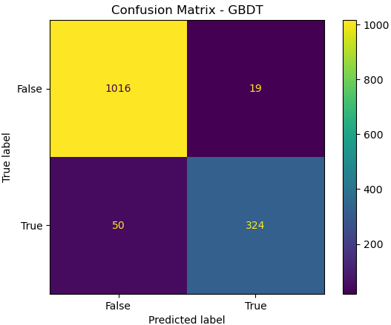
Confusion Matrix – GBDT Model
The GBDT model is highly effective, and using the test data, it correctly predicts that 324 subscribers are at high churn risk and 1016 subscribers are non-churners, with a reliable F1 score and recall scores. Also, 50 churned subscribers were not identified. This figure is relatively low compared to the correctly identified churn statuses.
These results also justify the chosen model to address this business case (Ahmed, 2024).
Accuracy
 | (1016+324)/(1016+324+50+19)=1340/1409≈95.1
Precision (Churn)
 | 324/(324+19)≈94.45 → When the model predicts churn, it's right ~94% of the time.
Recall (Churn)
 | 324/(324+50)≈86.6 → It correctly identifies ~87% of actual churners.
F1 Score (Churn) | Harmonic mean of precision and recall:
 | F1≈90.35
 | Predicted: No Churn | Predicted: Churn
Actual: No Churn | 1016 (True Negative) | 19 (False Positive)
Actual: Churn | 50 (False Negative) | 324 (True Positive)
Notes:
The GBDT model is highly effective, and using the test data, it correctly predicts that 324 subscribers are at high churn risk and 1016 subscribers are non-churners, with a reliable F1 score and recall scores. Also, 50 churned subscribers were not identified. This figure is relatively low compared to the correctly identified churn statuses.
These results also justify the chosen model to address this business case.

Slide 8
Business Value & Financial Impact
Reduce Income Leakage – If we continue at the current churn rate, the company will lose about $426,000 monthly in revenue. However, when these subscribers are proactively retained, the company may earn as much as $1,348,000 in revenue monthly.
Cost-Saving – It costs 5 to 8 times more to gain a new subscriber than to retain existing ones. Predicting possible churn outcomes and employing retention strategies can save the company millions of dollars.
Competitive advantage – with an accuracy score of 93%, predictions can target high churn risk subscribers with special offers, retention plans, and loyalty programs.
Market share – As subscribers are retained and new clients are gained, the company’s market share in the telecommunication industry is maintained and expanded for higher profitability and long-term sustainability.
Interactive Dashboards & Reports – User-friendly and intuitive displays, suitable for non-expert users to make fast and agile decisions.
Improved Resource Allocation – instead of exerting much energy on gaining new subscribers with marketing efforts, more of these resources can be channeled towards nurturing existing subscribers (Pandey, 2024)
Notes:
This slide considers the business value of our chosen churn solution. First revenue leakage will be checked, as Taco-Tel stands a higher chance of earning more revenue at the end of the reporting cycle. We also get to save cost for gaining new customers which is 5 to 8 times the amount is costs to retain existing subscribers. Accurate predictions will give the company a competitive advantage in the telecommunications industry and maintain its market share. The dashboards and reports generated will help decision makers quickly make agile decisions.

Slide 9
Recommendations
Based on the benefits outlined in this presentation, we suggest that the subscriber churn prediction model (GBDT) be deployed and integrated with the company’s existing CRM and Business Intelligence tools with real-time churn notifications.
Use the churn model outcomes and customer lifetime values (CLTV) to segment and target high churn risk subscribers with personalized retention efforts.
Implement live support agents and chatbots to improve customer experience.
Consistently track KPIs such as churn value, CLTV, and customer satisfaction for continuous improvements.
Invest in subscriber feedback systems, such as surveys, to monitor customer satisfaction levels, service issues, and competitor trends for improved customer experience.
Notes:
Integrating the GBDT model into the existing customer relationship management (CRM) system of the company, with churn notifications and customer segmentation, will enable the company to take immediate steps towards retaining high churn risk subscribers. The key is to act before the customer abandons their subscriptions. Personalized ads make the customer feel seen and catered to. One of the complaints received from subscribers is the time it takes to get issue resolved, employing the services of chatbots can greatly reduce the turnaround time. In addition, continuous improvement is important, therefore, the model and data must be monitored and adjusted when need. Finally, receiving and monitoring customer feedback is vital to the growth of any business, invest in feedback loops for heightened customer experiences.

Slide 10
Summary
Business Problem: Taco-Tel’s revenue generation is under pressure due to rising customer churn.
Data Preparation: Data quality is the foundation for any reliable machine learning model.
Solution: Developed, trained, and tested five machine learning techniques to predict subscriber churn - GBDT was chosen because it is the most accurate.
Test Results: Test F1 score – 93.5%, Recall – 92.4%, Confusion Matrix - Strong precision and fewer false positives.
Business Value: This solution prevents significant income loss, improves CLTV, saves cost, provides a competitive advantage, retains market share, and aids data-driven decision-making.
Notes:
In summary, Taco-Tel has a problem, and that is consistently increasing customer churn rates, which puts the business under pressure. To fix this, we need to rely on the customers’ historical data. Also, to ensure that this data is beneficial to the business, it must be of high quality and consistent, because data quality is the foundation for any reliable machine learning model. We chose various models, tested them, and picked one - the GBDT with the highest accuracy scores. Its confusion matrix gives a strong precision with fewer false positives. This solution prevents significant income loss, improves CLTV, saves cost, provides a competitive advantage, retains market share, and aids data-driven decision-making. With these few points of mine, I hope I have been able to convince you of the business value inherent in the implementation of this solution.

Slide 11

THANK YOU
references
Harina Rastogi. April 28, 2022. What is Churn Rate? Pros, Cons and Examples. Analytics Steps. https://www.analyticssteps.com/blogs/what-churn-rate-pros-cons-and-examples
Ruchi. December 21, 2023. Gradient Boosted Decision Tree — Clearly Explained. Medium. https://medium.com/@ruchi.awasthi63/gradient-boosted-decision-tree-clearly-explained-bd1d8c7d9923
Saravana Kumar. December 12, 2022. Customer Retention Versus Customer Acquisition. Forbes. https://www.forbes.com/councils/forbesbusinesscouncil/2022/12/12/customer-retention-versus-customer-acquisition/
Nisha Arya Ahmed. November 10, 2024. What is A Confusion Matrix in Machine Learning? The Model Evaluation Tool Explained. Data Camp. https://www.datacamp.com/tutorial/what-is-a-confusion-matrix-in-machine-learning
Architaa Pandey. July 25, 2024. Facing High Customer Turnover? Here’s How Customer Churn Prediction Helps. UpShot.AI. https://www.upshot.ai/blog/customer-churn-prediction
Notes:
Here are my references. Thank you.

